Slide 1
MVC DESIGN PATTERN
<<Empowering Development: Unveiling MVC - Streamlining Structure, Enhancing Flexibility.>>

Slide 2
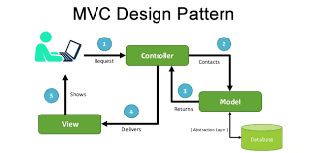
Purpose and Motivation
The purpose of MVC is to separate the user interface (UI) and the underlying data (business logic). This means each component does one thing, and can be changed without affecting the other components. It tackles the Separation of Concerns in computer science.

Slide 3
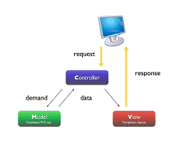
Purpose and Motivation
In real life, how the data is presented (UI) changes more frequently than the data itself (business logic). Thus, the motivation behind MVC is to let developers and designers work parallelly, so UI changes can be made without affecting the underlying data or logic.

Slide 4
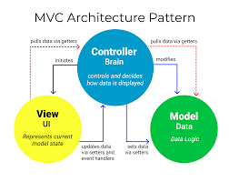
Intended Use Cases
● MVC can be used where parallel development is needed. That means different people can work simultaneously on different components without affecting or blocking others. A popular example is the division of front-end and back-end developers.
● MVC is useful when the same piece of data has to be presented to the user in multiple ways (e.g. pie chart and histogram) at the same time.

Slide 5
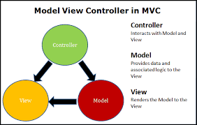
STRUCTURE
Vocabulary
● Model - manages application data and its modification
● View - manages interface to present data
● Controller - manages interaction to modify data
Description of a simple use case of the MVC model
In a sandwich shop, when you order a turkey sandwich, the clerk (Controller) relays your request to the sandwich-making station (Model).
The sandwich-making team, equipped with various ingredients, assembles the turkey sandwich based on your order.
Finally, you receive the completed turkey sandwich (View).

Slide 6
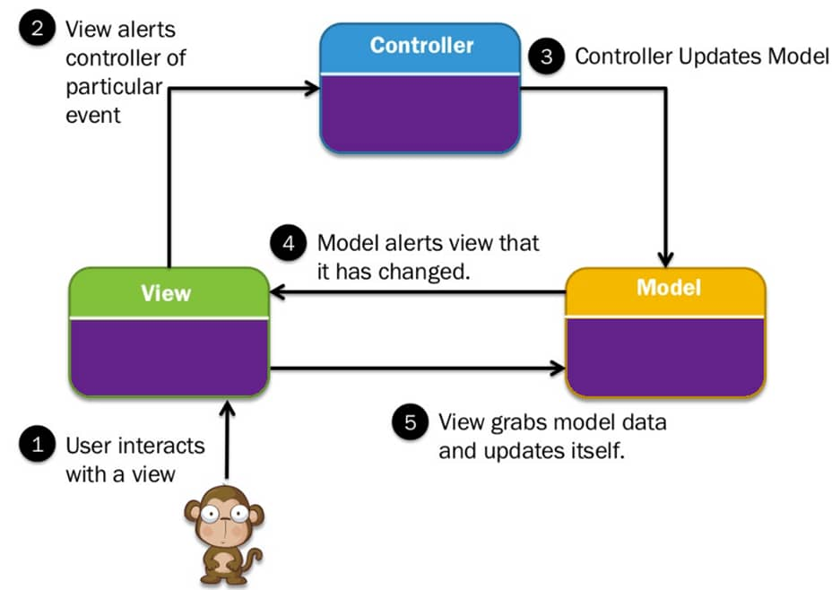
How does it works?
● The user perceives View and send requests to Controller.
● Controller decide how to modify Model according to the requests.
● Model may interact with a database, and if it is modified, it will notify View(s) that there are some changes needed to be updated.
● View retrieves the changes and refreshes itself with the updated data
● The user perceives the updated view.

Slide 7

Advantages
What can be the advantages?
● Simultaneous or parallel development - Several people can work at the same time on the code.
● Model is domain independent and Code can be reused .
● Multiple views can be created based on one model.
● MVC has loose coupling between models, controllers and views.
● High cohesion is also enabled in MVC between views and controllers.
● Testing can be done separately for the different components since testing UI is usually expensive.

Slide 8
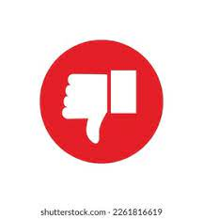
Disadvantages
Did you know?
● Navigation of code can be complex since there are many different components and abstractions which require time to adapt to them.
● Consistency should be maintained throughout the code for navigation and readability. Otherwise, it causes scattering and difficult to read.
● Using MVC requires the knowledge of multiple technologies, like a web application can require the knowledge of HTML, PHP, SQL. So, the learning curve is high for this pattern compared to others.

Slide 9
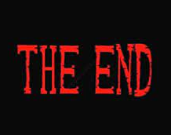
Thank You!!
Thank you all for joining today's presentation. Just as a sandwich requires the right combination of ingredients for a perfect taste, your engagement and participation have enriched our discussion on the MVC design pattern. Your presence has added flavor to this session, and we appreciate your time and attention. If you have any further questions or insights, feel free to reach out. Here's to building well-structured and delightful software together.

